Slide 1
Siyaphumelela Building Student Success through Data Analytics
June 27, 2014

Slide 2
Today’s agenda (1 hour)
Overview of Kresge and our grantmaking
Challenges and opportunities for South African postsecondary student success
Outline of the Kresge grant opportunity and grantee role
Applicant commitments
Selection Criteria
Deadlines
Resources
Texted audience questions

Slide 3
Overview
Kresge is a $3+ billion private, U.S. foundation that supports opportunities for low-income people in cities.
Education promotes postsecondary access and success for low-income, first generation and under-represented students.
In South Africa, we focus on building university advancement capacity with our partner, Inyathelo, and on promoting student success.

Slide 4
Kresge Grantees in South Africa
R270,000,000+ in grants since 2005
Western Cape: CPUT, UCT, UWC, Stellenbosch, Inyathelo
Gauteng: UJ, Wits, TUT, Pretoria, SAIDE
KZN: DUT
Free State: UFS
Eastern Cape: Rhodes
Access and Success (since 2012):
VC and Academic Development focus groups
South African Survey of Student Engagement
Achieving the Dream
Pretoria Access and Success Conference
Student Access and Success report

Slide 5
Challenges
Weak student success rates
Lack of clarity for what works best to enhance student success
Academic Development varies from institution to institution and between departments within institutions
Lack of integration between IR, AD, ICT, student services and academic departments
Variability in IR capacity
Lack of a national, systemic response

Slide 6
Opportunities
DHET Learning and Teaching grants
CHE Quality Enhancement project
Increasing interest in using data analytics to improve student success
SASSE
Access to cutting-edge international thinking on similar issues
Emerging models overseas: Scotland, Achieving the Dream, Georgia State University

Slide 7
Siyaphumelela Concepts
Focus on building and integrating data analytics capacity
Build from existing momentum
Create a cohort of institutions building experience in data analytics
Work through common challenges to build a shared vocabulary and national models
Top-10 failure rate courses
High Impact Practices like First-Year Experience
See what practices have the most positive impact

Slide 8
Siyaphumelela Goals
Improve capacity to collect student data and integrate it with IR, ICT, academic development, student services, planning and academic divisions
Create SA models of universities using successful data analytics to improve student outcomes
Create a greater awareness and support for data use to improve student success in South Africa
Create and highlight a shared vocabulary and consensus on especially effective practices to improve student success
Enlarge the cadre of experienced data analytics professionals supporting student success

Slide 9
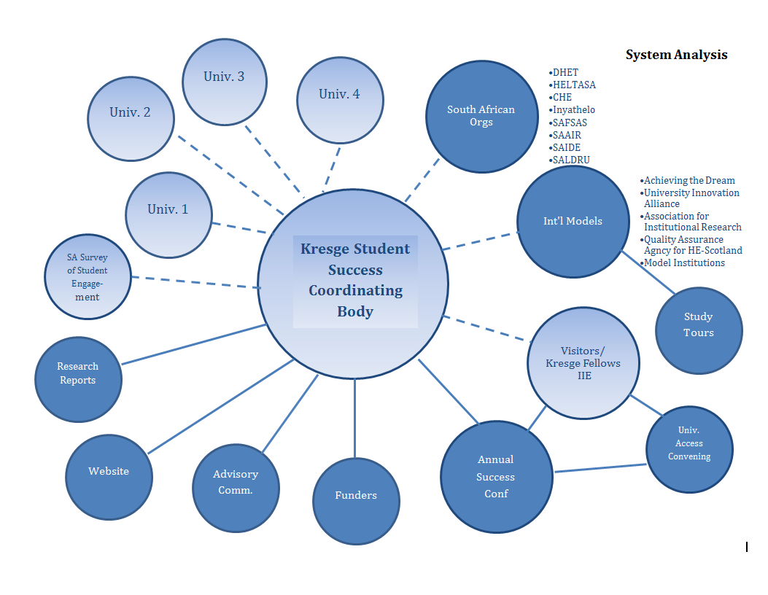
Siyaphumelela! We Succeed!

Slide 10
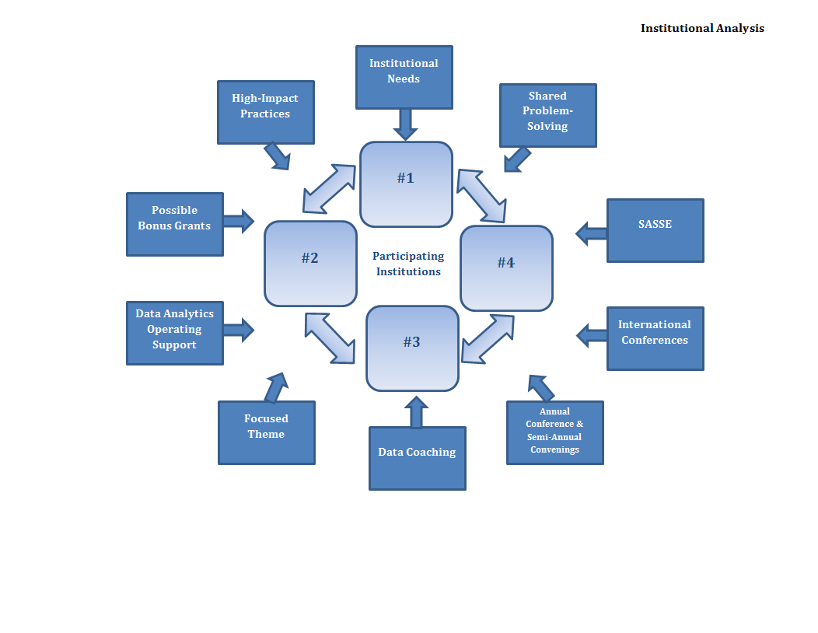

Slide 11
Applicant Commitments
Commit to strengthening and integrating data analytics among institutional research, ICT, AD, planning student services and academic divisions
Establish, or developing a plan to establish, a broadly representative student success task force.
Agree that VC will participate in annual conference.
Commit to reducing student outcomes differences and to full participating in the initiative and network.
Look at the top-10 failure rate courses.
Use SASSE to assess student engagement.
Participate in the proposed national discussion of a High Impact practice
Provide updates and reports as required
Declining grant payments over the course of the initiative

Slide 12
Selection Criteria for the 8-10 page Initial Concept Paper
Institutional Profile: Who are you, who do you educate, how do you fit in the SA higher education system, what are your student success challenges?
Strategic Vision and Leadership Commitment: What is the VC’s strategy for the university and how does student success fit within it? How would participating in Siyaphumelela could benefit your university and are there existing student success goals. How much time does the VC have?
Institutional Research Capacity: How well do your IR, ICT, AD, Academic department and student services work together to improve student success? What could be improved? How would this grant be used to improve things? What’s missing?
Integration Plan and stakeholder Agreement: How will you get everyone to work together? What are the barriers? What have you done recently, especially under the current VC, to improve student success?
Strategy in Context: How would you use this grant to complement the DHET Teaching and Learning grants, or the CHE’s Quality Enhancement efforts, on your campus?

Slide 13
Other important factors
Useful Resource documents:
Building Institutional Capacity for Data-Informed Decision Making
High Impact Educational Practices
Next Generation University
Student Access and Success: Issues and Interventions in South African universities
White Paper for Post-School Education and Training
Framework for Institutional Quality Enhancement in the Second Period of Quality Assurance
Initial Concept Papers are due on July 14, 2014
Send to Siyaphumelela@Kresge.org
Site Visits:
Five to seven finalists will have site visits August 4-13, 2014

Slide 14
William F.L. Moses
Managing Director Education Program
wflmoses@kresge.org
3125 W. Big Beaver Road
Troy, Mich. 48084 USA
1-248-643-9630
kresge.org

