Slide 1
Diego Rivera, Public Pensions and Detroit’s Bankruptcy: What’s Philanthropy Doing in the Middle? Rip Rapson, President and CEO Philanthropy Forum at the University of Pittsburgh Graduate School of Public and International Affairs O’Hara Student Center
April 8, 2014

Slide 2
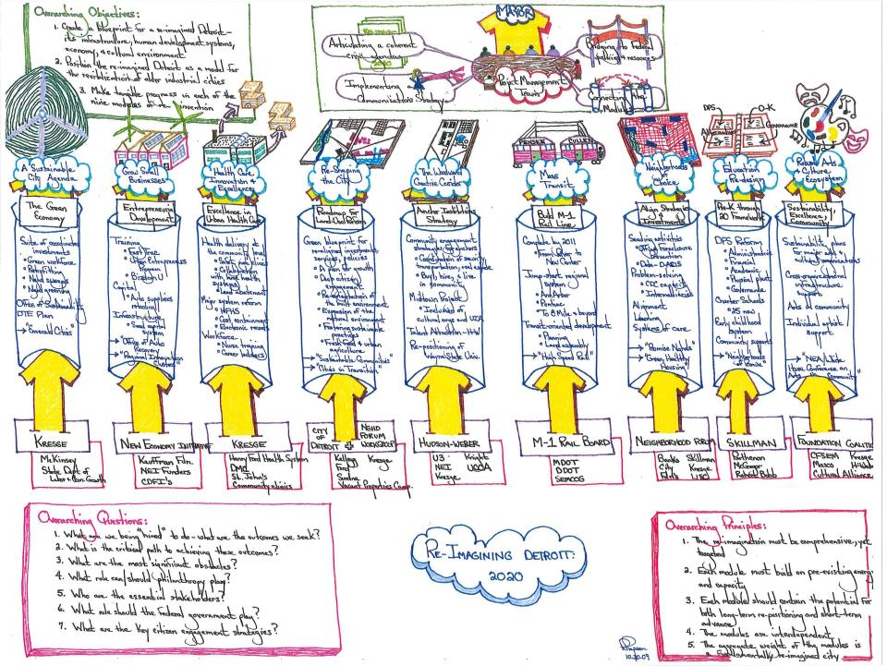

Slide 3
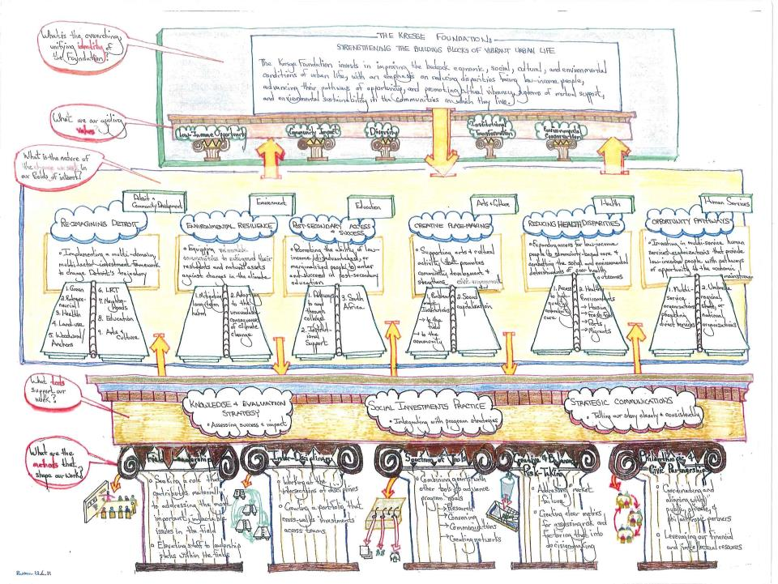

Slide 4
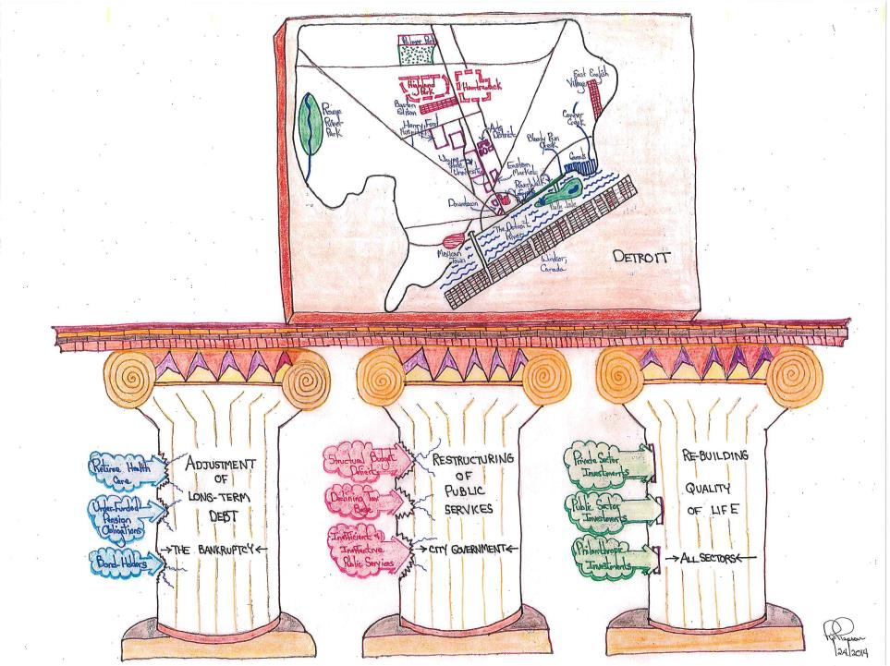

Slide 5
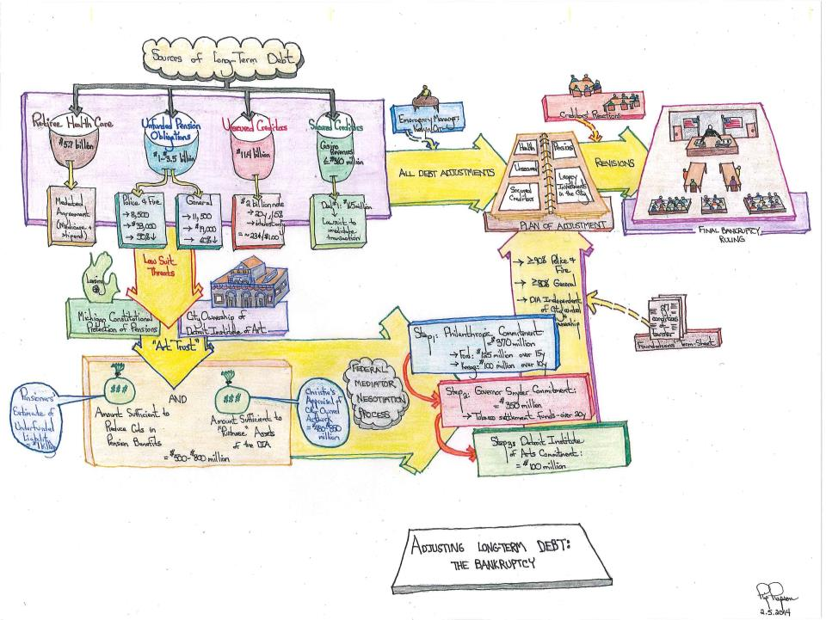

Slide 6
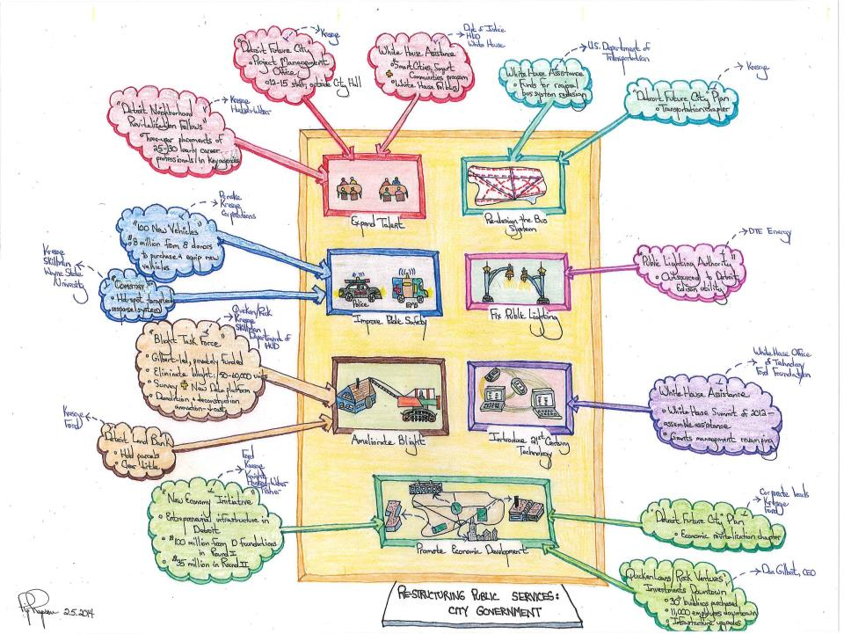

Slide 7
